Slide 1

PROJECT 1

Slide 2
Project 1 Team
Irene Zou
Jeff Lyng
David Stagner

Slide 3
HYPOTHESIS
Olympic athletes have improved performance significantly over time.

Slide 4
Project Overview
We will analyze summer Olympic games gold medalist data from 1896 to 2016 for 5 specific track & field events for both male and female.
100 meter
800 meter
10,000 meter
High Jump
Discus
We will also analyze height and weight data for the athletes that competed in these events.
Data Source
Kaggle
Olympic Track & Field Results csv
120 Years of Olympic History: Athletes and Results csv

Slide 5
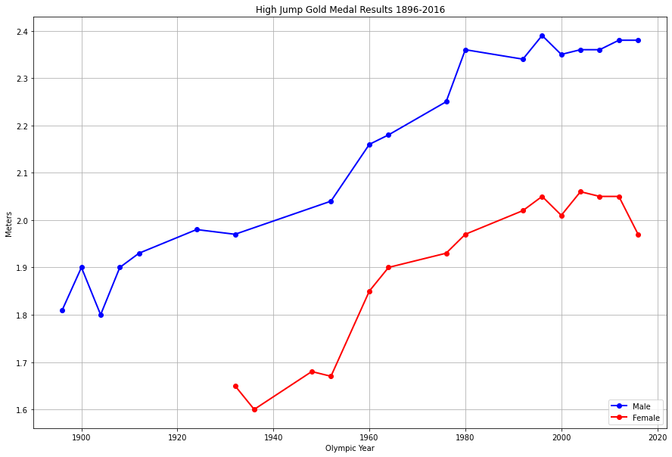
High Jump Results

Slide 6
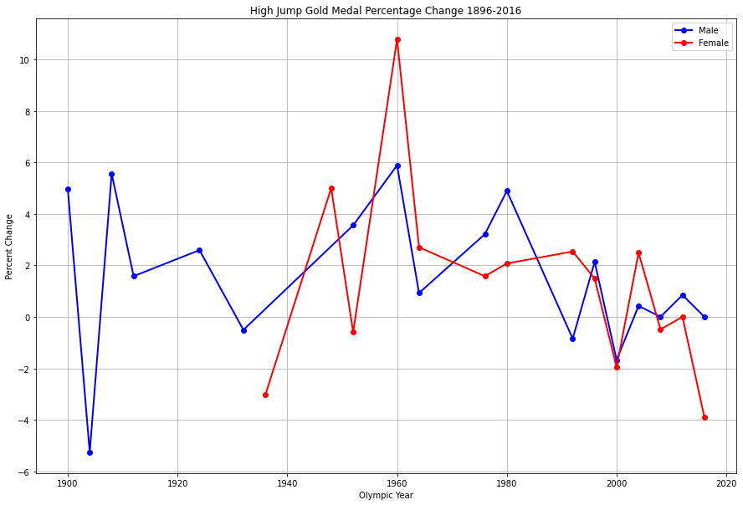
High Jump Percent Change

Slide 7
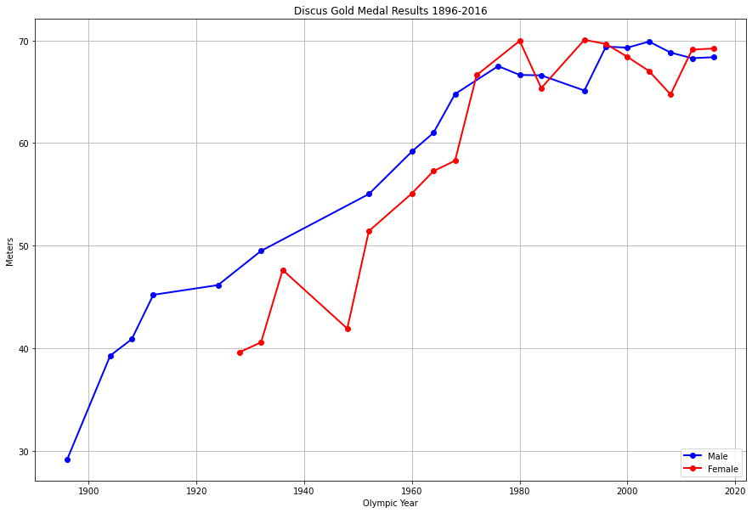
Discus Results

Slide 8
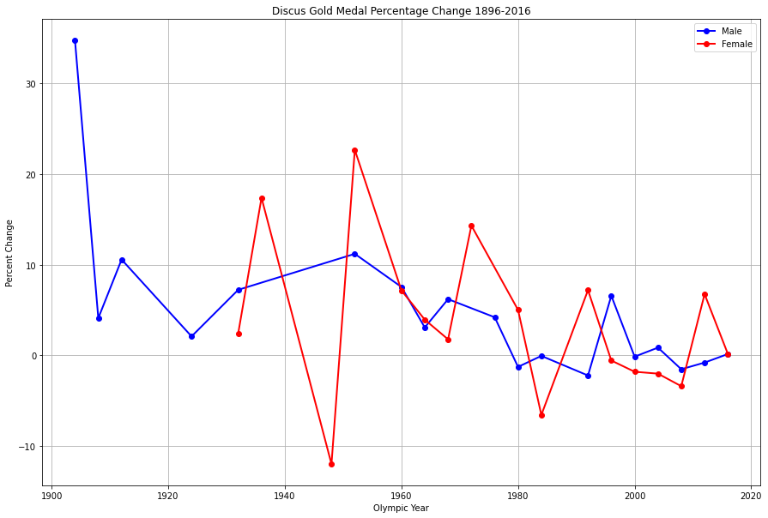
Discus Percent Change

Slide 9
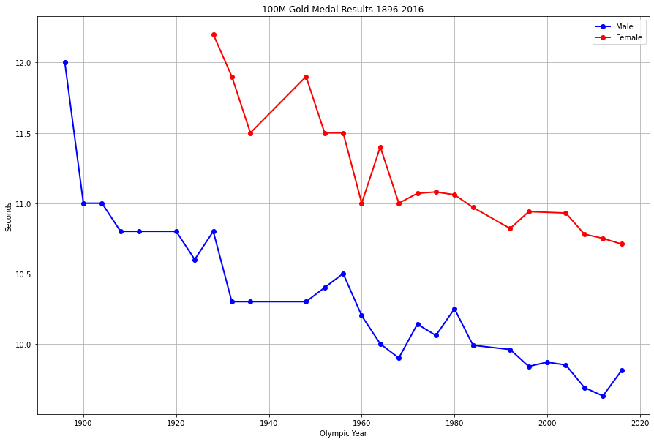
100 Meter Results

Slide 10
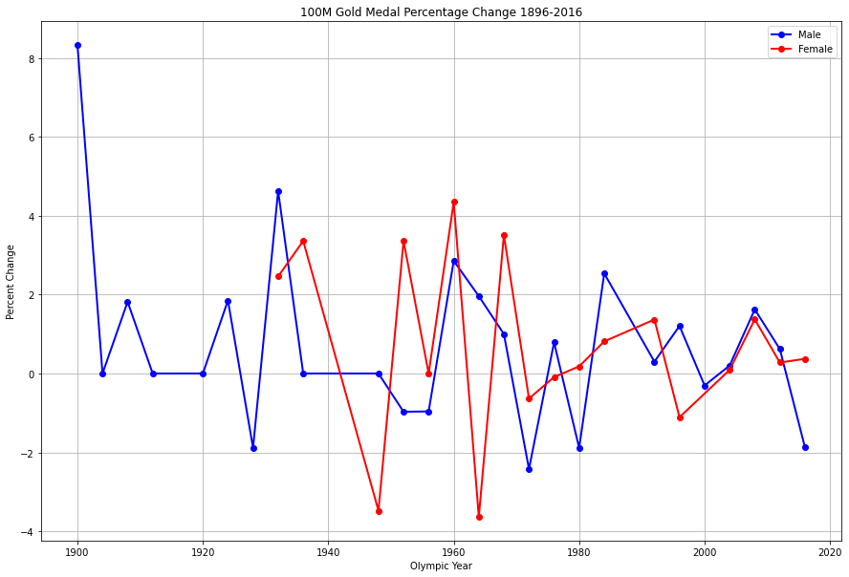
100 Meter Percent Change

Slide 11
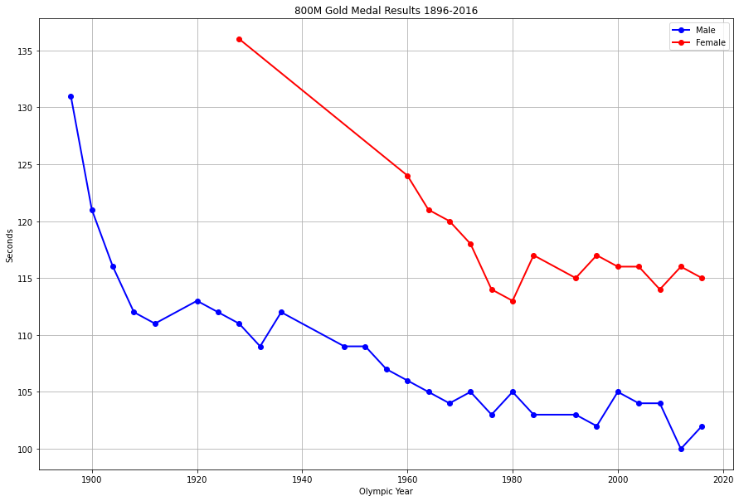
800 Meter Results

Slide 12
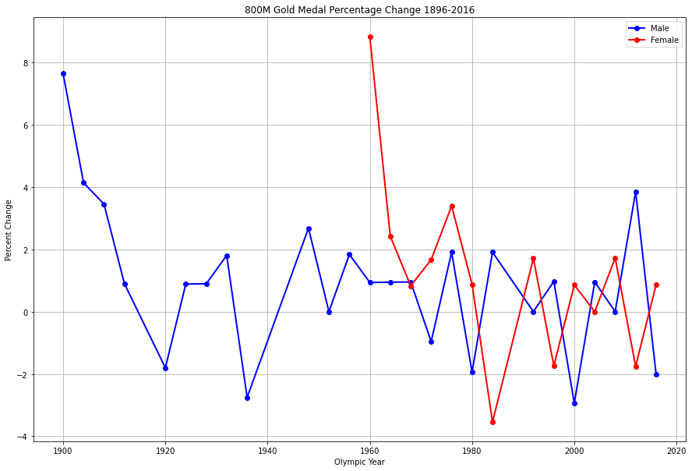
800 Meter Percent Change

Slide 13
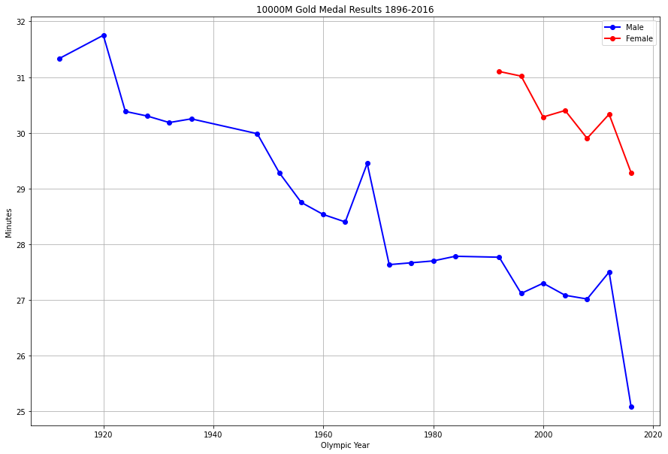
10,000 Meter Results

Slide 14
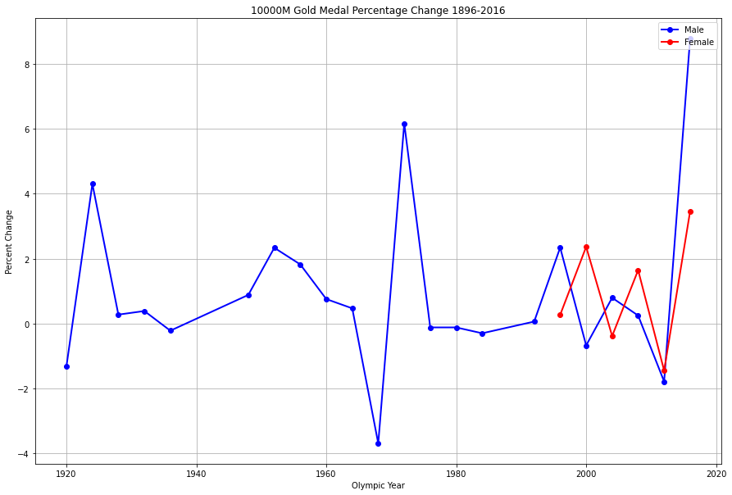
10,000 Meter Percent Change

